Slide 1


Slide 2
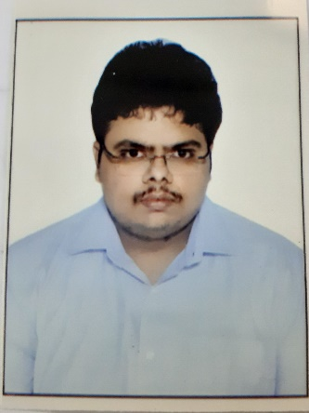
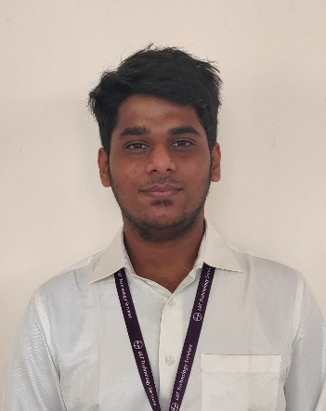
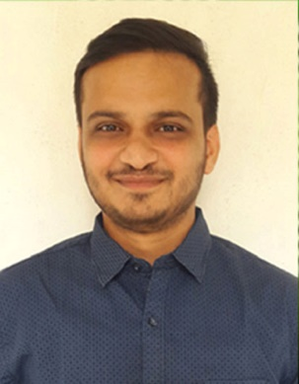
Project Highlights
Project Name : Java Script
Team Size : 3
Team Members Details :
Aman Kumar Mishra
99002631
2009MYSEMB_03
B.Tech - ECE
MVNSK Aditya
99002471
2009MYSEMB_03
B.Tech - ECE
Koushik K
99002512
2009MYSEMB_03
B.Tech - ECE

Slide 3
Project Video Snippet

Slide 4
Future development that can be implemented further

Slide 5

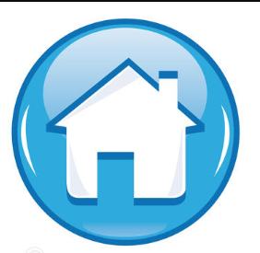
Thank You !

